Slide 1

Welcome to “Married to the Military”
For each couple, please:
Fill out nametags with your first name and wear them
Take one of each
  Married to the Military Book
  Welcome to the Army Family Booklet
  Military One Source Folder
  Handouts (slides, questionnaire)
Help yourselves to refreshments
Tonight’s guests are:
1LT Tim Schriver and Kylee
1LT Parker Collins and Christy (INARNG)
Lieutenant Colonel (LTC) Dion Bates and Sheryl
Kim Bridgewater

Slide 2
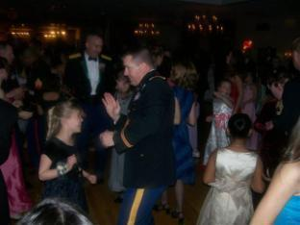
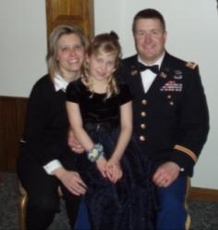
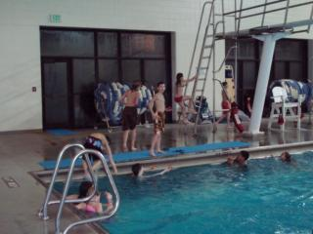
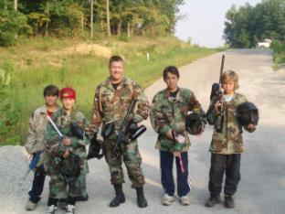


The Army isn’t made up of people...
… the Army is People

Slide 3
Married to the Military
  Army 101
  Financial
  Physical
  Recreational
  Social
  Academic
  Medical
  Mental
  Spiritual
  Open Discussion

Slide 4
Which Career Path?
Active Duty
  Most Competitive
  Army is full-time job
National Guard
  Army is part-time job
  Work for a state
  Units are usually Combat Arms
Reserves
  Army is part-time job
  Work for the federal government
  Units are usually support units

Slide 5
Obligation/Commitment
Differs greatly, depending on contract(s)
Normally, the Mandatory Service Obligation (MSO) is 8 years. That means 8 years of service in the military. Can be all Active duty, all national guard, all reserve or a combination.
If receiving active duty, minimum is 4 years on AD. Remainder of MSO can be whatever is desired (AD/Gd/RS/IRR)
ADSO (3 more years of AD to get what you want)
  Branch
  Post
  Grad School
SLRP (Student Loan Repayment Program)
  Up to $25,000 – one additional year of active duty
  $25,001 - $50,000 – two additional years of AD
  $50,001 - $65,000 – three additional years of AD

Slide 6
Army 101
The Army has two main components
Institutional Army
  Training centers, training units, schools
Operational Army
  Deployable, combat, combat support units
  Active Duty, Guard, Reserves
    Active Duty – 540,000 (73k officers, 73k women, 56% married)
    National Guard – 360,000 (32k officers, 51k women, 44% married)
    Reserves – 200,000 (33k officers, 47k women, 45% married)
    Civilians – 220,000

Slide 7
US Army Force Structure
First Army
Third Army
Fifth Army
Field Army
(2-5 Corps)
Command Level
General
I Corps
III Corps
V Corps
XVIII Corps
Corps
(2-5 Divisions)
Corps
(2-5 Divisions)
Lieutenant General
10 Active Divisions
2 Integrated Divisions
8 ARNG Divisions
Divisions
(3-5 Brigades)
Major General
10,000-18,000 Soldiers
Brigadier General
Or Colonel
Brigade
(3 or more Battalions)
Brigade
(3 or more Battalions)
Brigade
(3 or more Battalions)
3000-5000
Soldiers
Battalion
(3-5Companies)
500-900 Soldiers
Lieutenant Colonel
Company
(3-4Platoons)
Captain
100-200 Soldiers
Platoon
(3-4Squad)
16-40 Soldiers
Lieutenant
Squad
(4-10 Soldiers)
Staff Sergeant

Slide 8
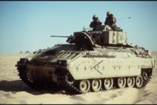
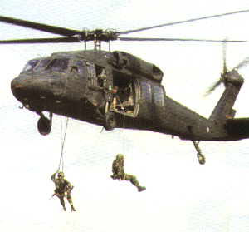


The Army Divisions
Armored
Mechanized
Airborne
Air Assault
Light
1
1
1st ID
Fort Riley, KS
OLD IRONSIDES
1st Armored Div
Germany
2nd ID
Korea
82nd ABN Div
Fort Bragg, NC
101st AASLT Div
Ft. Campbell, KY
10th Mtn Div
Ft. Drum, NY
3rd ID
Fort Stewart, GA
1st Cavalry Div
Fort Hood, TX
4th ID
Fort Hood, TX
25th Inf Div
Hawaii

Slide 9
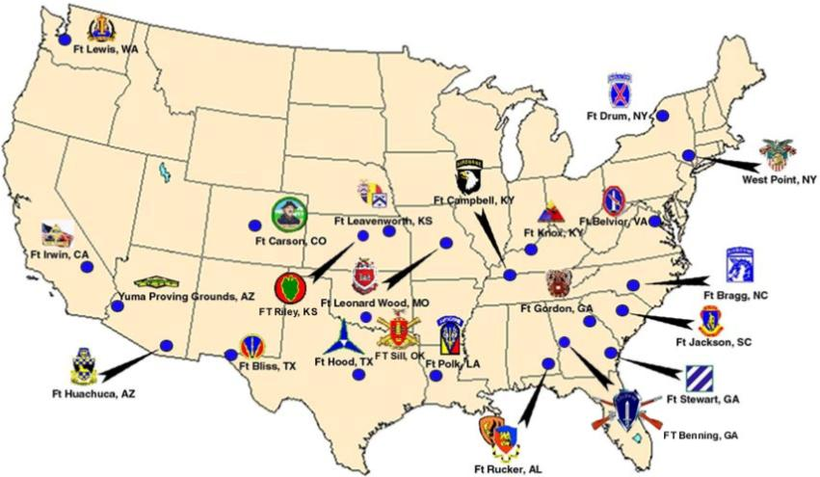
Army CONUS Stations

Slide 10
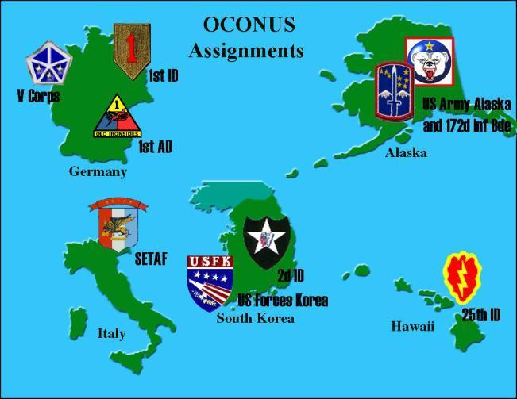
Army OCONUS Stations

Slide 11

















Basic Army Branches
Maneuver, Fires & Effects
Operations Support
Force Sustainment
Health Services
Infantry
Armor
Adjutant General Corps
Nurse Corps
Aviation
Field Artillery
Military Intelligence
Finance
Ordnance Corps
Military Police
Chemical Corps
Medical Services
Transportation
Signal Corps
Quartermaster Corps
Air Defense
Corps of Engineers

Slide 12
Army Life After College
Wait for your orders (weeks, months)
  Reserve/Guard – find a job
  Active Duty/Gd/Rsv can do Gold Bar Recruiter on any campus (140 days or 179 days)
  Active Duty 2LTs can also do summer training camps (LDAC/LTC)
Attend your branch-specific Basic Officer Leader’s Course (BOLC)
  At basic branch training institution
  Varies from 13 to 20 weeks (AV = 1 year)
Attend follow-on schooling (airborne, ranger)
Report to first duty station (active duty) or go back to hometown and to your civilian job (NG/AR)

Slide 13
Army Benefits
Active Duty
  30 days paid vacation a year (max 60/75 days*)
  Annual pay raises
  Promotional pay raises
  Advanced civil schooling
  Military schooling
  Career progression
  Family medical / dental health and life insurance
  Travel (and plenty of it)
  PX and Commissary benefits
  Social network
  Post privileges
  Retirement Pay (upon retirement)
Reserve/Guard Duty
  One weekend a month
  Two weeks during the summer
  Steady income
  Hold a variety of civilian careers
  Promotional pay raises
  Military schools
  Financial support to continue higher education
  Possibility of Active Guard Reserve Duty
  PX and Commissary benefits
  Retirement Pay (at age 60?)

Slide 14
Financial
(Active Duty)
Monthly Pay = Base + Housing (BAH) + Subsistence (BAS) + Special Pay
Payment by EFT every 2 weeks
Pay raises every year (~3.5%), with every promotion, and at every 2nd year of service mark
Housing is provided on base for all, in exchange for BAH, if you choose.
Free tax return assistance/filing
Free legal aid (wills, powers of attorney)
Retirement Pay – 50% ++

Slide 15
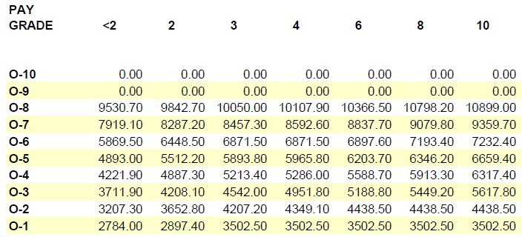
Base Pay
(Active Duty, 2011 rates)
Pay raise each year (2% - 3% usually)
Officer promotions usually occur at years 2, 4, 8, 16

Slide 16
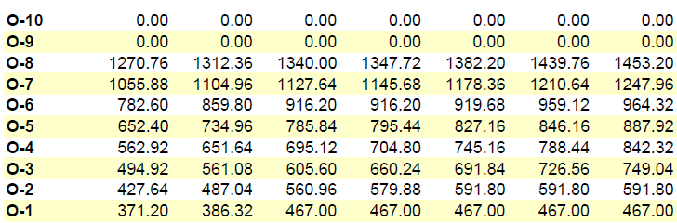
Drill Pay
(for one weekend, 2011 rates)
Soldiers usually are paid the full drill pay for one weekend of drill. This usually occurs 10-11 times each year.
In the summer, NG/AR Soldiers usually attend a two-week Annual Training, or “AT”, and are paid for two weeks of active duty

Slide 17
Other Recurring Monthly Payments
Housing (BAH)
  All Soldiers receive either BAH or on-base housing
  Different rates for single, married, dual-military
  BAH varies based on location (receive more for expensive areas)
  Example: BAH for Purdue is $1173 for a married 2LT, $969 for a single 2LT
Basic Allowance for Subsistence (BAS)
  $223.84 for officers, $325.04 for enlisted
Your salary as a new 2LT on active duty in 2012 would be approx $51,000, with only 2/3 of that taxed, and no health insurance or medial expenses (therefore add ~ $10,000)

Slide 18
Special Pay
Family Separation - $250 a month for each month separated
Hazardous Duty/Imminent Danger Pay $375 monthly
Combat Zone Tax Exclusion (no federal taxes on income)
Health Professional Pay
Aviation Pay
Dive Pay, Jump Pay
Recruiter Pay
Language Proficiency
Savings Plan while deployed (SDP, earn 10%)
Clothing Allowance (officers – once, $400; enlisted – annually)
Temporary Duty Pay (travel, lodging, meals)
Dislocation Allowance (= BAH++)
Do-it-yourself (DITY) moves

Slide 19
Other Financial Benefits
Health Insurance – full coverage, no cost
Dental Insurance – full coverage, small cost for family
Life Insurance - $400,000 soldier, $100,000 family for minimal cost
Possible state income tax exemption (depending on state)
Access to low-interest loans
Loan deferment for active duty (must speak w/ your lender)
AER loans (emergency)
Financial Counseling
Post Exchange / Commissary shopping

Slide 20
Physical
PT every day in the morning for soldiers
Excellent gyms on base, free use for family
PT facilities (tracks, sheds) everywhere
Organized aerobics, CR, dance for all
Intra-mural sports

Slide 21
Recreational
MWR – Morale, Welfare, Recreation www.armymwr.com
Gyms
Golfing
Bowling
Hunting
Fishing
Boating
Skeet/ranges
Hiking / Parks
Paintball
Water activities
Scuba/sky diving
Auto crafts
Arts and Crafts
Soldier Show, Concerts
Holiday Events
Youth Sports
Child Services/Events
Camping/RV spots, rentals
Movie Theater
Local trips
Reduced prices for local events
Pro sports events
Clubs/lounges on post
Lodging across the world
  400 CONUS
  50 OCONUS
AFRC (Hawaii, Disney, Europe)
Space-A travel

Slide 22
Social
Restaurants, lounges, clubs on post
Holiday meals in the dining facilities
Dining In/Dining Out
Unit runs
Spouses’ groups (Wives Clubs, PWOC)
Hails and Farewells
Army Ball, Branch/Regimental Balls
Dances (Father-Daughter, youth)
Formal/informal socials/parties with unit
Family Fridays, Aloha Friday
Army Family Team Building
Support to local events, Special Olympics

Slide 23
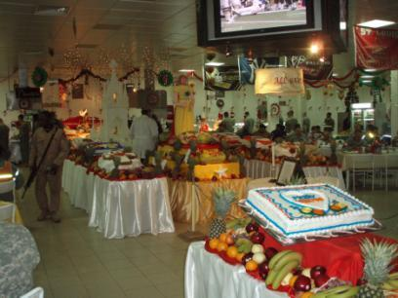
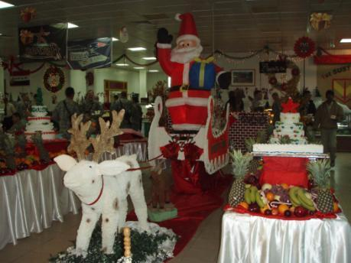
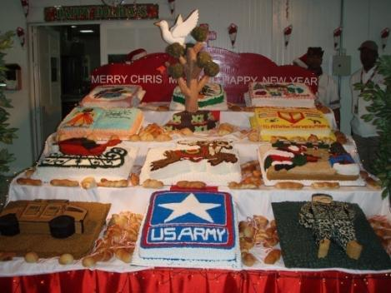

Slide 24
Medical
Tricare – Insurance plan for military
Large hospitals are on base, with many clinics and aid stations, pharmacies
  No cost if using MTF (Military Treatment Facility)
  No cost if using MTF Pharmacy
  Soldiers NEVER pay for medical care, whether on base or off, including pharmacy
Several dental clinics on base (for soldiers)
Veterinary Services on base

Slide 25
Mental
Army Community Service – ACS
Counseling
  Marital
  Financial
  Mental
  Career
  Academic
  Physical
  Substance Abuse

Slide 26
Spiritual
Many chapels on base with vibrant congregations
Many services each Sunday/Wed for all denominations
Chaplains are assigned to Battalions
Marriage retreats, single soldier events
Bible studies, men of faith events, Christian concerts on base
Protestant Women of the Chapel (PWOC)
Catholic Women of the Chapel (CWOC)

Slide 27
Married to the Military
Topics Covered
  Army 101
  Financial
  Physical
  Recreational
  Social
  Academic
  Medical
  Mental
  Spiritual

Slide 28
The “~Newlywed” Game
For the non-military “spouse”
What is the branch he/she wants
What is the desired location for first unit
What is his/her weakest PT event
Favorite pro sports team
Mother’s maiden name
For the officer-to-be
What is the anniversary of your first date/meeting
Favorite color
Favorite flower
Mother’s maiden name
Cats or dogs?

Slide 29
Words of Wisdom (for the guys)
  Always thank your spouse during speeches. Always.
  Always introduce your spouse to your boss.
  The 10,000 mile screwdriver does not work…ever
  “Fine” is a four-letter word, so is “okay”. Don’t use them.
  Listening is communicating. Sometimes you should just listen, and only respond (carefully) if asked.
  “How does this look on me?” is a trap. Run, or refer to # 4 above. Abe Lincoln in the Geico commercial got it wrong.
  Emails are not a soapbox to lecture from
  A joke does not transmit well over email from thousands of miles away
  It’s better to have the courage to call and say you’ll be late than to just show up late to a cold meal and a cold stare/shoulder
  It’s not always about you – your spouse has a life, too, and she wants you involved in it as well
  Don’t forget dates (anniversaries, birthdays, etc). Flowers, cards and flowers. Then, furniture.
  When you retire, the Army won’t be there, but your family hopefully will. Take care of them, and make them a priority.

Slide 30
Words of Wisdom (for the gals)
  Have patience with us.

Slide 31
Married to the Military
Topics Not Yet Covered
But Fair Game in Breakout Session
  The first move
  The first struggle
  Handling finances
  When to call your mother
  Raising children
  Having a career
  Getting help
  Your role as an officer’s wife
    Officer’s wives club
    Family Readiness Group
  Handling a deployment
  Handling a redeployment
And now…breakout sessions (guys go to another room)

