Slide 1
PURDUE ARMY ROTC 2011
Welcome to the Boiler Battalion
Notes:
http://www.youtube.com/watch?v=tlIZ4WkzPeI&feature=related

Slide 2
Agenda
Introduction
Leadership, Standards & Expectations
History
Cadet Life
Zero Week
Question/Answer

Slide 3
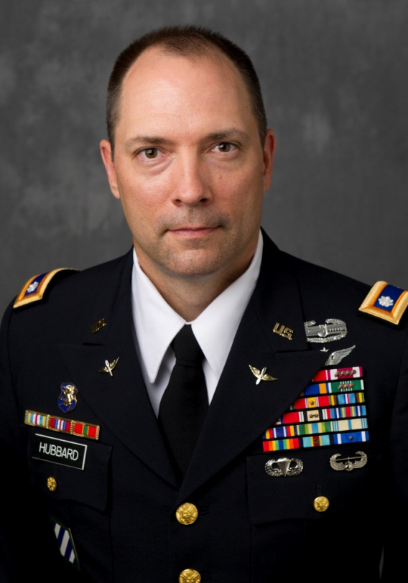
Lieutenant Colonel Jerry D Hubbard
B.A. Psychology, Southeastern University 1990
M.S. Information Technology, UMUC 2009
Recent Assignments
Observer/Controller – NTC, CA (2001-2004)
Operations & Training Officer – Iraq (2004-2006)
Attack Helicopter Executive Officer – Iraq (2006-2008)
NORAD-USNORTHCOM Washington D.C. (2008-2011)
Training
Aviation, Airborne, Air Assault
Major Awards
Combat Action Badge
Valorous Unit Award
Bronze Star (2 awards)
Air Medal
Defense Meritorious Service Medal
Meritorious Service Medal (4 awards)
Army Commendation Medal (3 awards)
Army Achievement Medal (2 awards)
DMG
Enlisted
Army Reserves (Alabama)
Army National Guard (Florida)
Officer
FT Rucker
FT Campbell
AC/RC
NTC California
FT Benning 3rd ID
HAAF 3ID (Savannah, GA)
Pentagon

Slide 4
Nitty Gritty
Alcohol
Drugs
EO/Sexual Harassment (PL 2/3)
Improper relationships
Senior cadets with junior/basic
course cadets
Standards (PL 13/14)
GPA
APFT
Leadership
Professional Courtesy
Accessions
The specific or practical details; the heart of a matter

Slide 5
CDT Lieutenant Colonel Andersen
Background
Why Army ROTC?
My Expectations

Slide 6
CDT CSM Anderson Expectations
Background
Major/Minors
Why Army?
Expectations

Slide 7
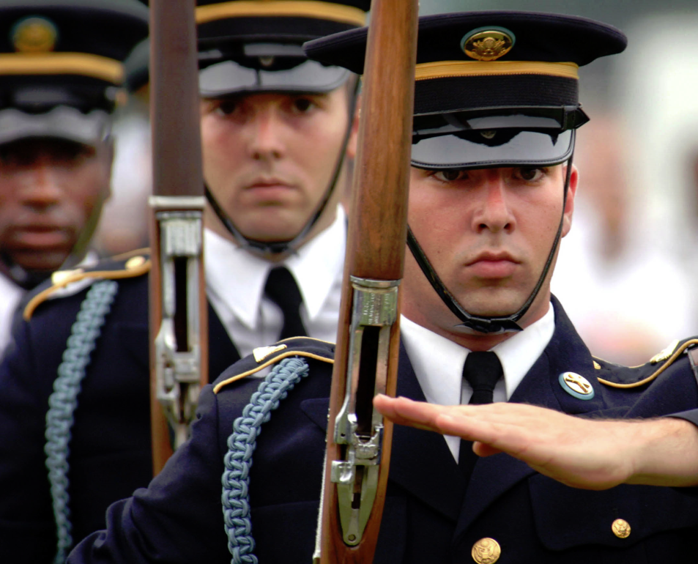
Standards
Commitment to Excellence
Military Bearing
Uniform
Physical Fitness
Academic
Discipline
Attendance
Work ethic

Slide 8
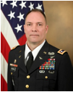
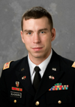
Cadre
Lieutenant Colonel Jerry Hubbard- Professor of Military Science, Department Head, MS IV Instructor Email: hubbarj@purdue.edu Phone: (765) 494-2099
Captain Anthony Blackburn – MSIII Instructor, Budget/Logistics Officer,
Ranger Advisor
Email: arblackb@purdue.edu
Phone: (765) 496-7581

Slide 9
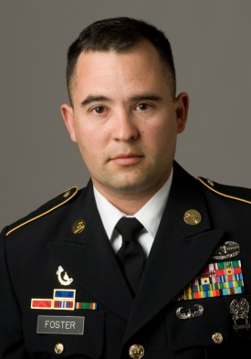
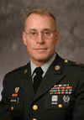
Cadre
Sergeant First Class Vincent Foster - Training NCO, Ranger Challenge Advisor, Pathfinders Advisor, Ranger Club Advisor, MS II Instructor Email: vmfoster@purdue.edu Phone: (765) 494-2103
Master Sergeant Eric Anderson - MS I Instructor, Rifle/Pistol Team Coach Email: andersej@purdue.edu Phone: (765) 494-2100

Slide 10
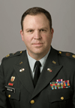
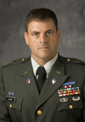
Cadre
Major Paul Heslin - Executive Officer, Commandant of Cadets Email: pheslin@purdue.edu Phone:(765) 496-9599
Major Travis Clark - Scholarship and Enrollment Officer, Ranger Advisor Email: clarkrt@purdue.edu Phone: (765) 494-2106 / (765) 479-0451

Slide 11
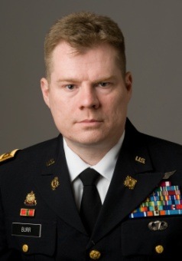
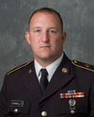
Cadre
Major Matthew Burr - Operations and Training Email: burr@purdue.edu Phone: (765) 494-0798
Staff Sergeant Kevin Connolly – National Guard Liaison Email: klconnol@purdue.edu Phone: (765) 494-9397

Slide 12
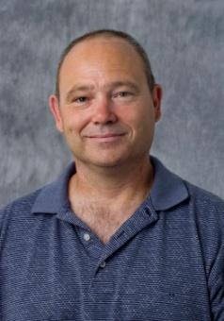
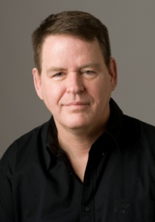
Staff
Mr. Frank Crusan - HR Tech (Cadet/Cadre Actions) Email: fcrusan@purdue.edu Phone:(765) 494-2107
Mr. Sam Sokolski - HR Tech (Cadet/Cadre Actions) Email: ssokolsk@purdue.edu Phone: (765) 496-2927
Mr. Gerald Smith - Supply Tech. Email: smit1245@purdue.edu Phone: (765) 494-2105
Mrs. Tarilee Terrell - Secretary Email: taterrel@purdue.edu Phone: (765) 494-2099

Slide 13
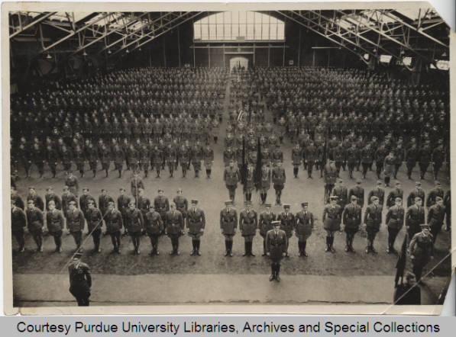
History of Purdue Army ROTC

Slide 14
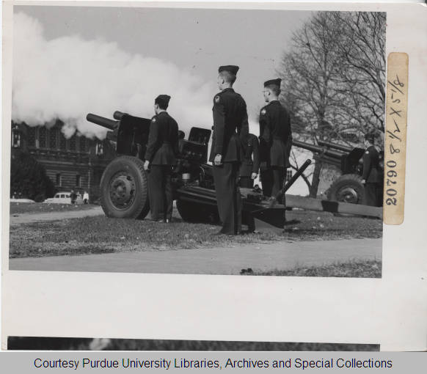
History
The Reserve Officers Training Corps was officially authorized by the National Defense Act of June 3, 1916
The Armory we are now in was completed in 1918 at a cost to the university of $200,000

Slide 15
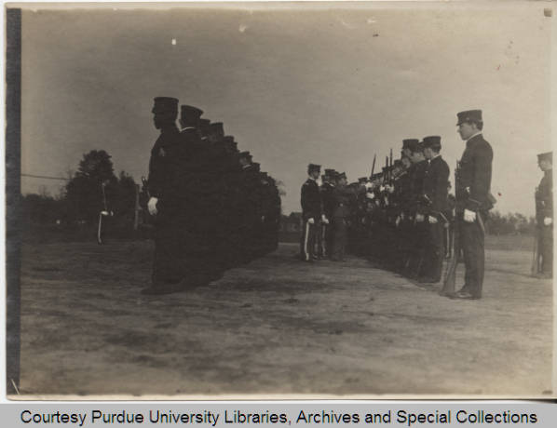
History continued
Until the 1965-66 school year, ROTC was mandatory for 17-21 year old males - enrollment for the 1966 school year dropped from 1,745 to 540
The 1973 school year was the first year that women were authorized to enroll in ROTC

Slide 16
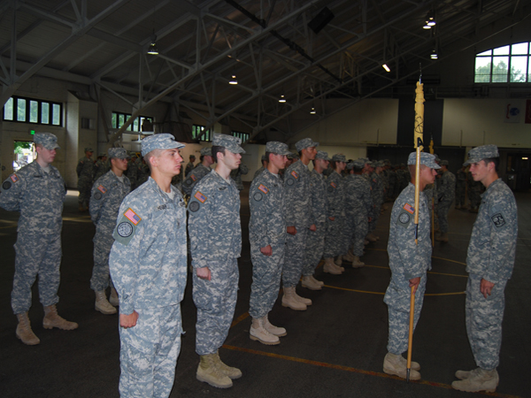
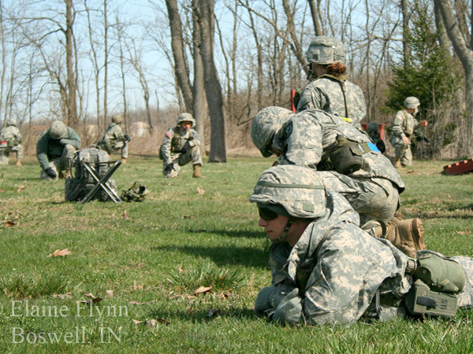
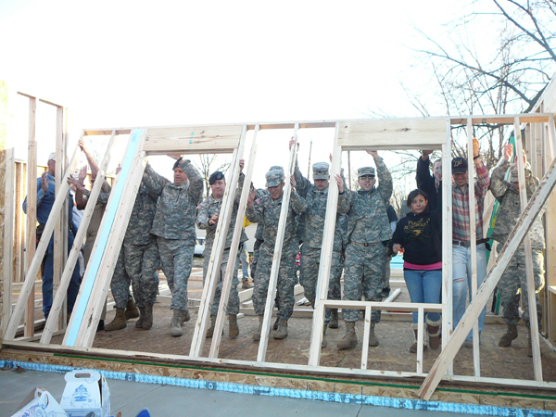
Cadet Life
Classes (MSL)
Leadership Lab
Physical Training
Field Training Exercise
Clubs/ Summer Opportunities

Slide 17
MSL Classes
Our Wonderful Instructors
MSL Books
Stay Organized
If you have any questions, just ask!

Slide 18
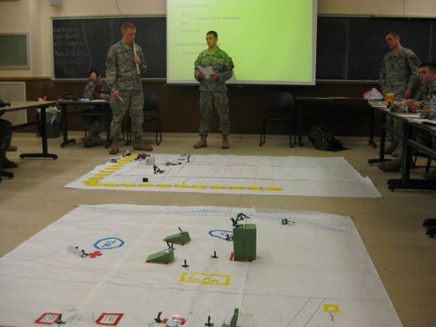
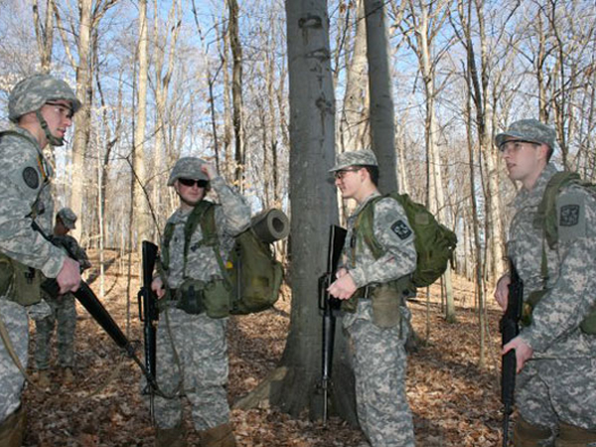
Leadership Lab
Thursday’s
1530-1720
Conduct Practical Training
Exercises
- Situational Training
Exercises
- Land Navigation

Slide 19
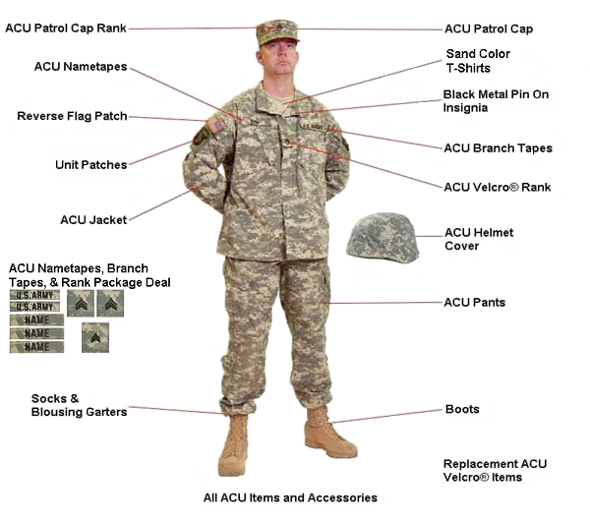
Army Combat Uniform

Slide 20
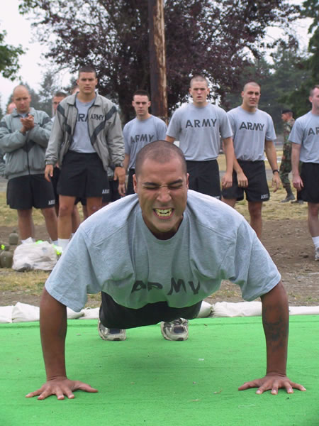
Physical Training
Tuesday, Wednesday, Thursday at 0600
Cadet Lead
Road Marches
Platoon PT
Ability Groups

Slide 21
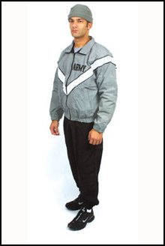
Summer/Winter PT Uniform

Slide 22
APFT
Events are the Push-Up, Sit-Up and 2- Mile Run.
Males 17-21 are expected to perform
Minimum Standards Maximum Standards
42 Push-Ups - 71 Push-ups
53 Sit-Ups - 78 Sit-ups
15:54 2-Mile Run - 13:00 2-Mile Run
Females 17-21 are expected to perform
Minimum Standards Maximum Standards
19 Push-Ups - 42 Push-ups
53 Sit-Ups - 78 Sit-ups
18:54 2-Mile Run - 15:36 2-Mile Run

Slide 23
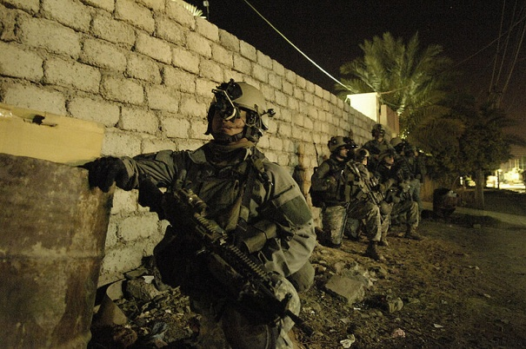
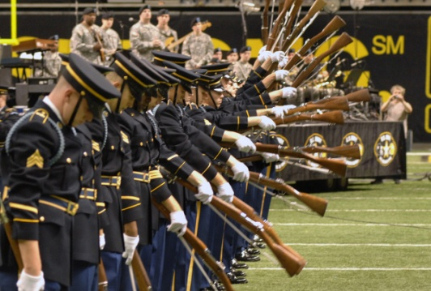
Clubs
Ranger Club
Ranger Challenge
Pathfinders
Pistol/Rifle Club
Drill Team/ Color Guard

Slide 24
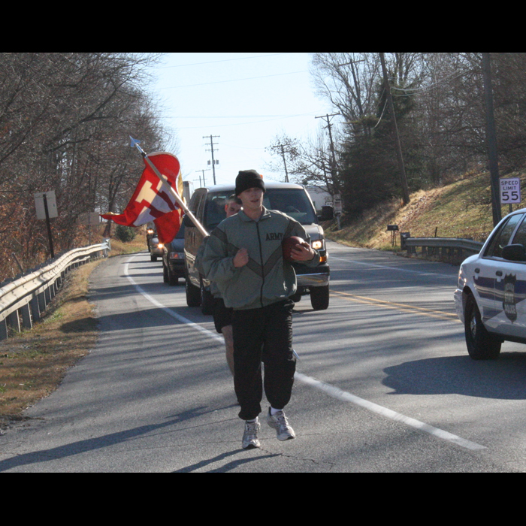
Events
Color Guard during Games
Homecoming Parade
Christmas Parade
Old Oaken Bucket Run
Tri-Service Run
JROTC Drill Meet
Grand Alternative Week Events
Dining Out

Slide 25
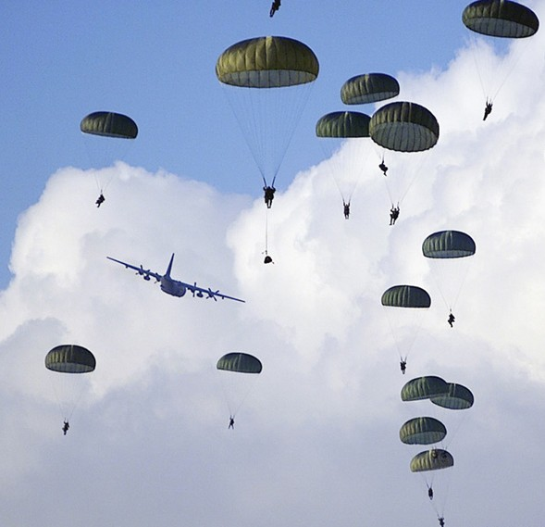
Summer Opportunities
Specialty Training
Airborne School
Air Assault School
Mountain Warfare School
Northern Warfare School
Robin Sage
Basic Training (National Guard only)
AIT (National Guard only)
NTSP (Nurses only)
CULP

Slide 26
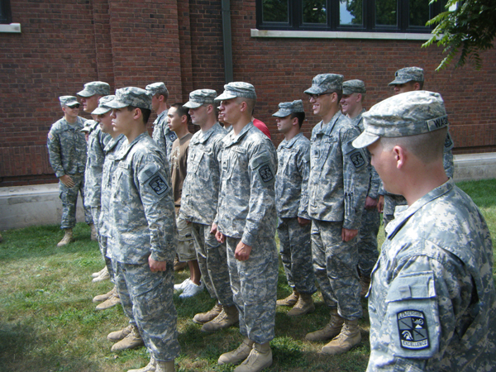
Zero Week
Paperwork with Mr. Crusan and Mr. Sokolski
MRE Lunch
Classes with the MSIV’s
Equipment Issue
Mentorship Dinner
Battalion Run
Award Ceremony
Cook Out

Slide 27
Question/Answer
BOILER UP!
Army Motivation

